Slide 1
Virtualization Station Serial Ports Install SOP

Slide 2
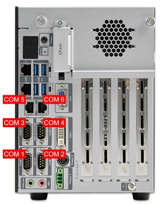
Serial Redirect Setup
Serial tab
Redirect COM Port page
COM1~COM6
You can assign COM port to VM in this page

Slide 3
How to Redirect 6 COM Ports
When you assign COM Port,the VM must turn off.
one VM the max can assigned 6 COM Port

Slide 4
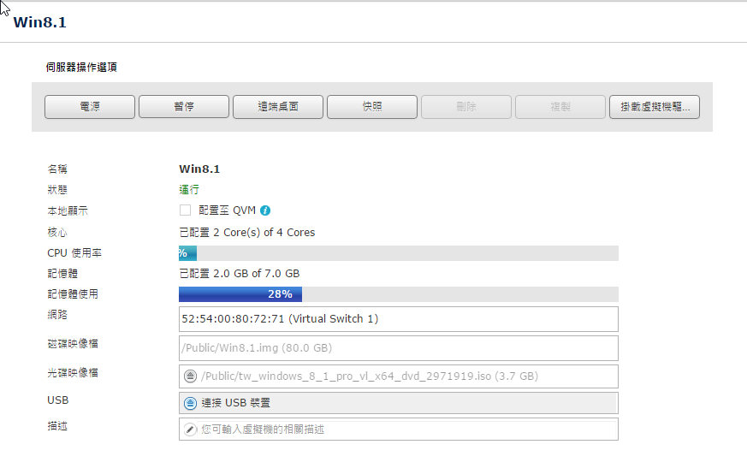
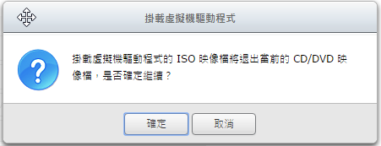
Insert VM Driver
COM1 and COM2 don’t need install driver
COM3 / COM4 / COM5 / COM6 need install driver
Virtualization Station already has driver , you must install the COM port driver manually
(driver folder is qemupciseria )

Slide 5
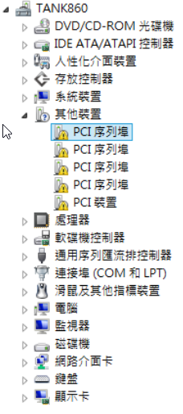
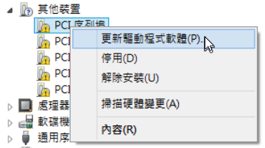
Install Driver
In the device manager will see the PCI serial port , you need to install the Driver to be able to use ( from top to bottom to install the driver, COM4 ~ COM6 port number will be correct. If not follow this steps , the com port number will be wrong)
3
4
5
6

Slide 6
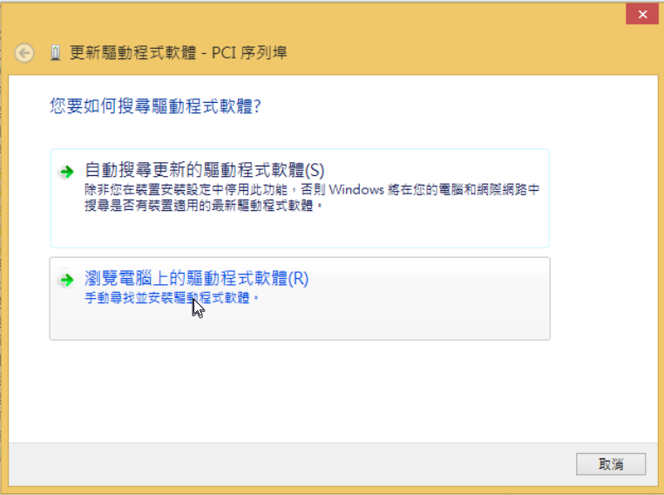
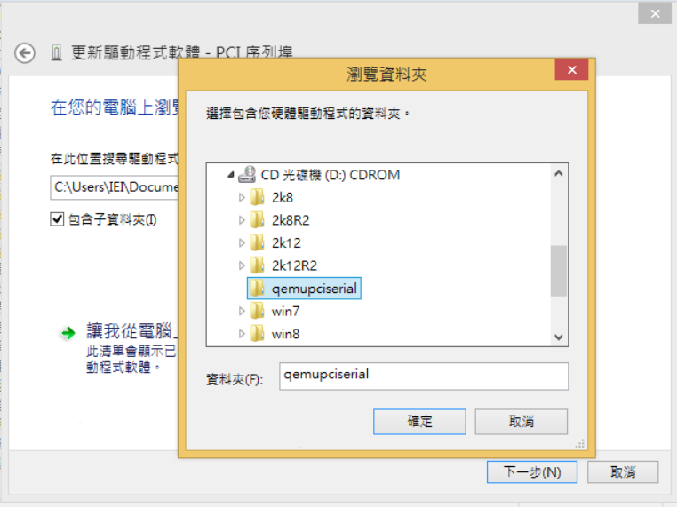
Install Driver
Chose the driver in qemupciserial folder

Slide 7
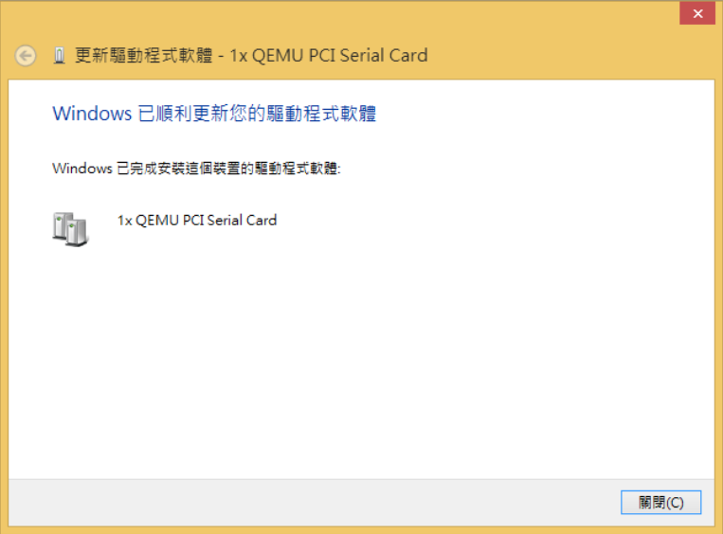
Install Driver
Install finished
Because each installation is for only single device, so each COM Port device need to perform an installation (please follow the order from top to bottom, the mapping of COM4 ~ COM6 mapping location will be correct)

